Slide 1
FACTORED AI & DATA HACKATHON 2026
Disputes with limits
Instant refunds for customers. Zero overreach for the bank.
An AI agent that resolves unrecognized-charge disputes at Banco LATAM in Spanish and Portuguese, with approval limits written in code, not in the prompt.
1 chat
61%
to resolve a dispute that takes 15 days today
of disputes solved with no human
Team DataMastersGT · Guatemala
Marcos Diaz · Daniel Machic
Notes:
Intro: we built an agent that resolves card-dispute conversations for Banco LATAM. The key idea: the model talks, but the code holds the permissions.

Slide 2
A customer waits 15 days. Triage does not help
"I don't recognize this charge." At Banco LATAM that starts a 15-day wait, and 1 in 5 cases still misses its deadline.
A 'Critical' case misses its deadline as often as a 'Low' one
Complaints are solved on first contact less than half as often as other requests
The question: How do we decide fast without giving up control?
Notes:
Situation: ~2,093 unrecognized-charge disputes a year, US$2,458 average, ~22% late. Complication: priority labels do not predict lateness (about 20-22% in every group), and complaints get solved at first contact 43% of the time vs 90% for transactions. Question: how to automate with control.

Slide 3
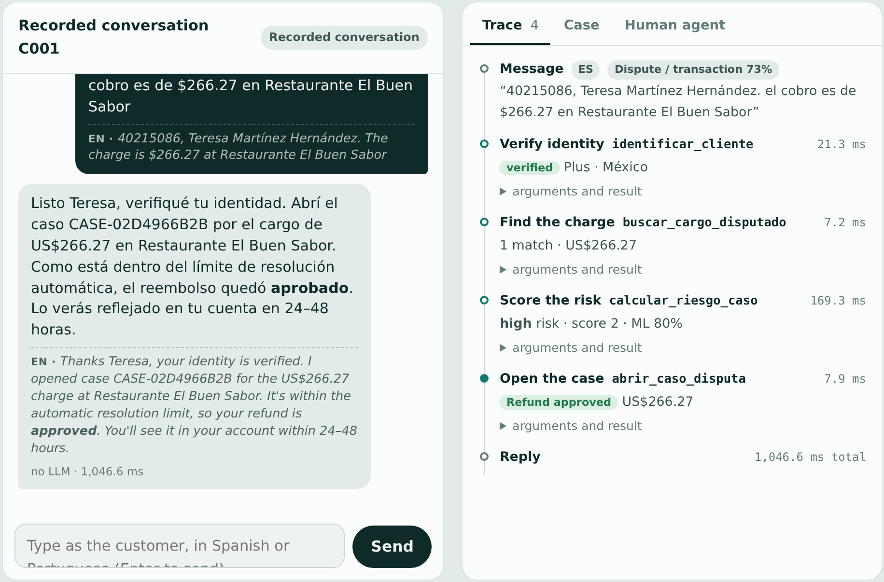
What it looks like: one conversation, three outcomes
Normal resolution
AUTO-APPROVED
US$243.63
Under the US$300 limit, no fraud signal. Refund approved instantly.
Ambiguous
STANDARD REVIEW
US$344.04
Above the auto-approval limit, low risk, no fraud signal: standard review.
Human escalation
ESCALATED TO HUMAN
US$4,189.18
Above US$1,500: mandatory handoff to a specialist, with full context.
Also in the demo: a US$210 charge with fraud score 79 goes to the fraud team, even though the amount is small.
Notes:
Left: the live demo. The conversation is in Spanish or Portuguese with an English subtitle under every message; on the right an auditor sees every tool that ran and what the code decided. Here the charge is under US$300 with no fraud signal, so the refund is approved on the spot. On the right are the three outcomes, using real customers from the dataset that are preloaded in the demo: auto-approved, standard review (above the limit but low risk, neither approved nor escalated) and human escalation (above US$1,500). A fourth demo customer shows fraud: score 79 goes to the fraud team even though the amount is small. Same code path in Spanish and Portuguese.

Slide 4
Why a bank can trust it: the model talks, the code decides
1
Customer
2
AI model
3
Permission gate
4
Outcome
Chats in Spanish or Portuguese. Identified by document + full name.
›
Only chooses which tool to call and with what arguments.
›
Python code. Reads amount, risk and channel from bank data, never from the model.
›
Auto-approve, standard review, or human handoff, with a full audit trace.
Limits written in code
Risk score = amount vs. typical, prior complaints, category, channel, customer value
≤ US$300, no fraud signal
US$300 to 1,500, low risk
≥ US$1,500
→ Auto-approved
→ Standard review
→ Human, mandatory
Verified identity (ID + full name)
3 failed ID tries or 15 min idle
Fraud signal, Regulator channel, or high risk above US$300
→ Case can proceed
→ Session locked
→ Human
Notes:
Risk is a score that adds points for: amount above the typical claim, prior complaints on record (bank data, not what the customer says), high-severity category, regulator channel and high-value customer. Two points or more = high risk. Walk the flow left to right. If the model is manipulated, it still cannot move these limits. If there is no API key or the model fails, a deterministic agent with the same tools and permissions answers. Columns: green = go, amber = review, red = human.

Slide 5
Proof: accurate, safe and explainable
Our models score far above the simple rules (points out of 100)
Past complaints and amount claimed drive the risk score
Simple rule: a fixed keyword list for requests, one amount limit for risk.
Our model: learns patterns from examples and combines several factors.
61%
~1,280
0
~20 ms
of disputes solved with no human
disputes a year spared the 15-day wait*
unsafe cases in 21 manipulation attempts
per turn, without the AI model
Notes:
*Illustrative: 2,093 disputes a year x 61% containment (measured on 170 test conversations) = ~1,280. Scores are macro F1 x100. Simple rule = keyword list (intent, 0.451) and a single amount threshold (risk, 0.623). Our models: TF-IDF + logistic regression (0.887) and a random forest on combined factors (0.791). Bars on the right are relative feature importance from the risk model. Safety and speed figures come from 170 real-data conversations, ES + PT, with the rule-based agent (no LLM). Intent was tested on phrasings the model never saw.

Slide 6
Ready for a pilot: what comes next
1
Pilot
Now
2
Validate
Next
3
Scale
Then
Connect Banco LATAM sign-in, customers and core systems
Run in shadow mode on real disputes
Human specialists keep the final word
Train risk on real outcomes, not our rule
Test with real Spanish and Portuguese conversations
Persistent audit log, load and injection tests
More languages and channels
Periodic retraining and monitoring
PII protection, compliance, separate environments
›
›
Limits we are upfront about
Dataset is 100% Spanish, so Portuguese cases are synthetic · Risk label is our documented rule, not the bank's · Intent phrases are synthetic · 57% of transactions lack a USD amount · Friendly fraud is not detected (exposure capped at US$300 per case) · Demo sign-in is document + name, not strong authentication
The permission gate is solid and tested. Link: disputas-datamastersgt.onrender.com
Notes:
Sign-in and users: the demo uses the 150,000 existing customers (any Active one can sign in with document + name); we did not add users because creating and authenticating customers belongs to the bank's core system and real authentication (OTP, biometrics). Inactive customers are rejected, and only charges from the last 90 days can be disputed. Be upfront about friendly fraud: a customer who really made the purchase and disputes it anyway cannot be detected with this data. What protects the bank today: the US$300 automatic cap, risk from prior complaints, one dispute per charge, and a full audit trace. Next step: escalate customers with 3+ disputes in 30 days and check prior payments to the same merchant. Frame limits as the roadmap, not as weaknesses: the gate does not depend on the model behaving well. What remains is real data, real integration and production hardening. The ask is a pilot.

